Slide 1

Brain Tumor Stage-Based Recurrence Patterns
Dataset Overview and Exploratory Analysis
Submitted by: Dana Sela 314813429, Miriam Chavay 213287790, Ayal Adler 209520998, Tamar Krakover 213273105.
Submission Date: 15 \ 01 \ 26
Course: Data Analysis in Python

Slide 2
Dataset Overview
Dataset name: Brain Tumor Stage-Based Recurrence Patterns
Source: Kaggle
Direct link to dataset:
https://www.kaggle.com/datasets/thegoanpanda/brain-tumor-stage-based-recurrence-patterns/data
File type: CSV file
Link to Github:
https://github.com/seladan1/Final-Project.git

Slide 3
The Core Questions
Can we predict the chances of a tumor recurrence based on its initial location?
Is there a correlation between the survival time and the age of the patient (at the time of diagnosis)?
Is there a connection between the survival time and the patient's gender?
Can we predict the treatment outcome based on the chosen treatment?
Can tumor type predict the tumor grade at initial diagnosis?

Slide 4
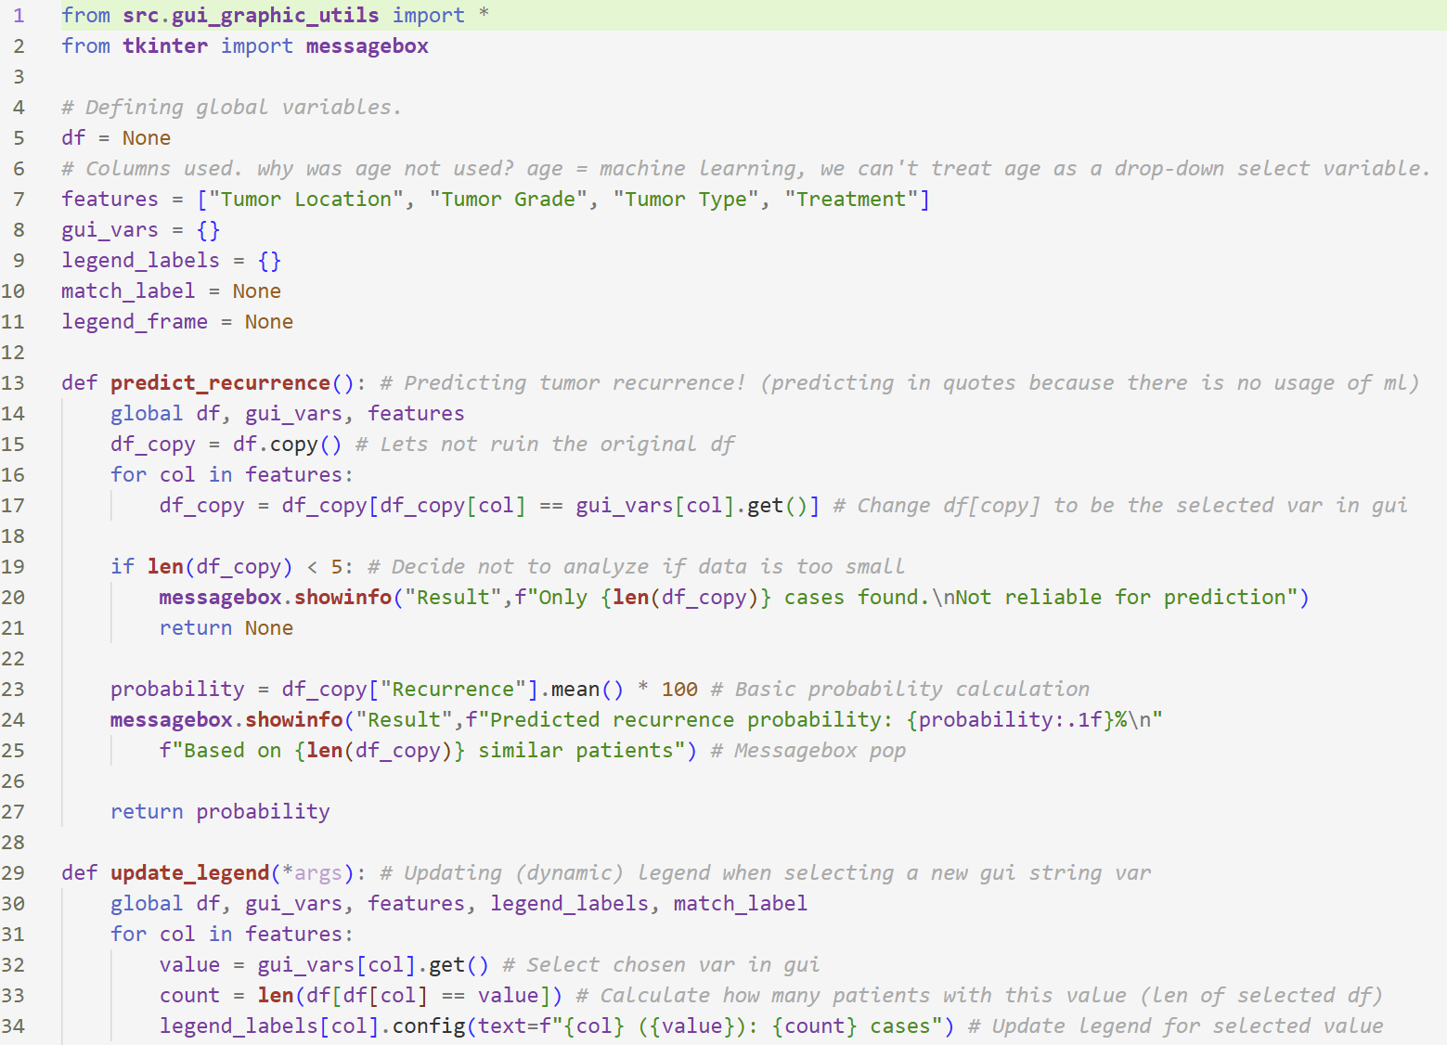
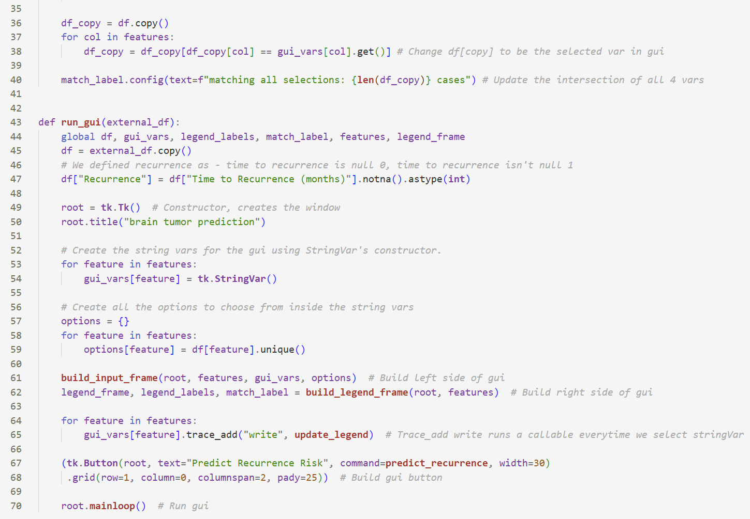
1. Can we predict the chances of a tumor recurrence based on its initial location?
Final code

Slide 5
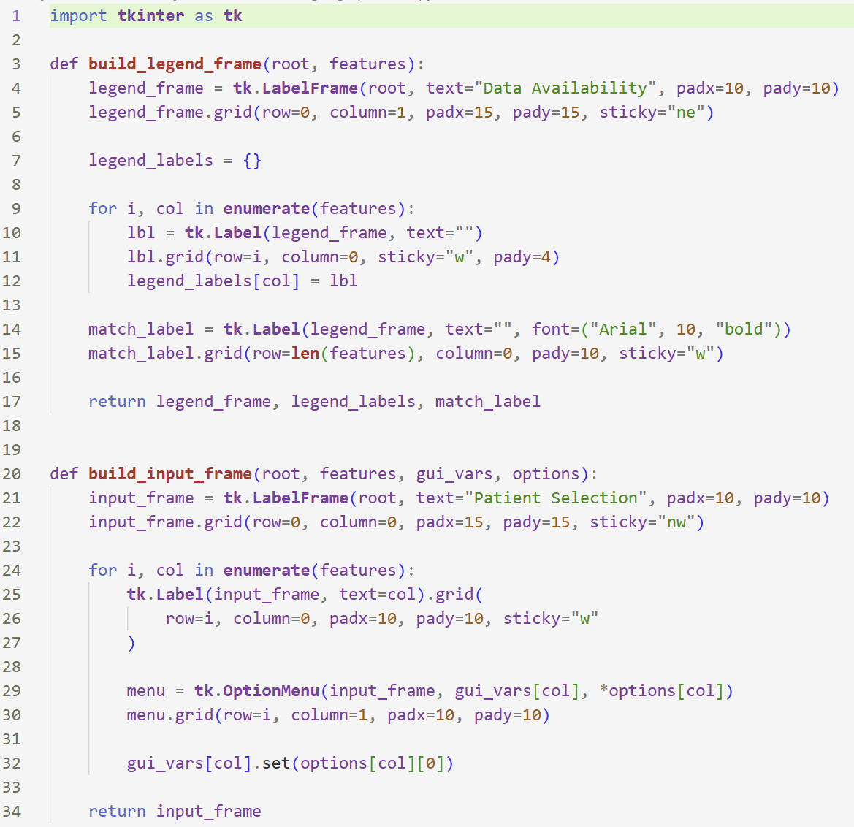
1. Can we predict the chances of a tumor recurrence based on its initial location?
Final code – gui graphic design

Slide 6
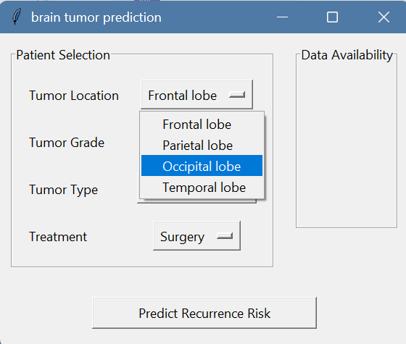
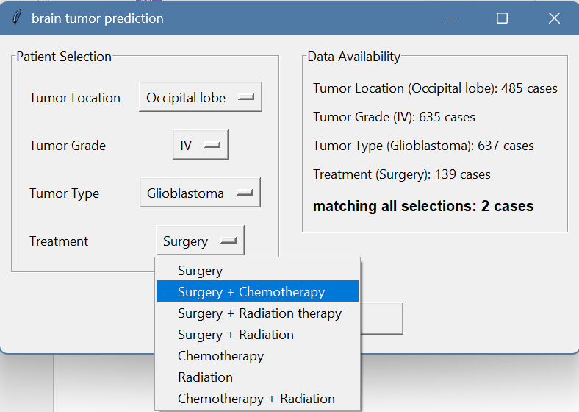
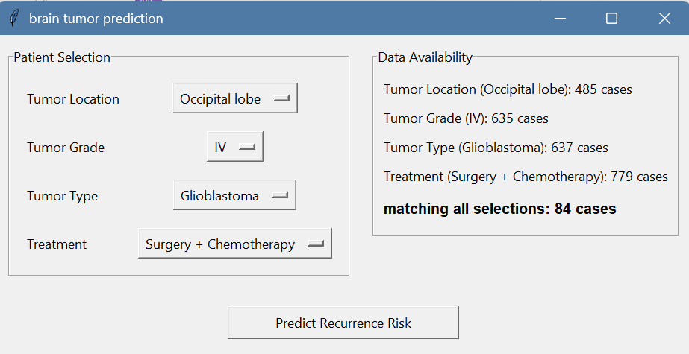
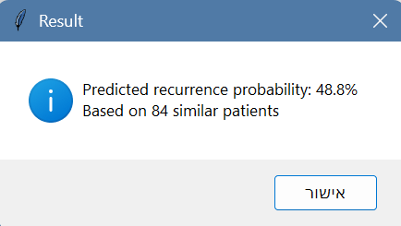
1. Can we predict the chances of a tumor recurrence based on its initial location?
Results
בתחילת העבודה עניינו אותנו שאלות על קשרים בין משתנים, אבל מאוד רצינו להוציא תוצר פרקטי מהעבודה, לדוגמה מוצר שיכול לחזות תוצאות תחלואה על סמך חלק מהמשתנים. תוך כדי עבודה הבנו שחיזוי תוצאות משתייך בעיקר לעולמות ה ML , אבל עדיין היה לנו חשוב להביא תוצר פרקטי - אז הסבנו את העשייה ממוצר שחוזה תוצאות תחלואה לפיתוח gui באמצעות חישוב הסתברותי של חיתוך בין קבוצות המחשב סיכוי לחזרת הגידול. מטרתו לאפשר לרופאים, לחוקרים ולכל מי שעוסק בניתוח הנתונים שלנו לבחון ולנתח אחוזי תחלואה בצורה פשוטה, אינטואיטיבית ונגישה. יצרתי טור חדש שבו כל ה NAN מתורגם לכך שהגידול לא חזר – 0, אם הוא חזר - 1. בכל חישוב הוא לוקח את כלל האנשים שחזר להם הגידול ומחלק בסך האנשים שחישבנו בכל קבוצה.

Slide 7
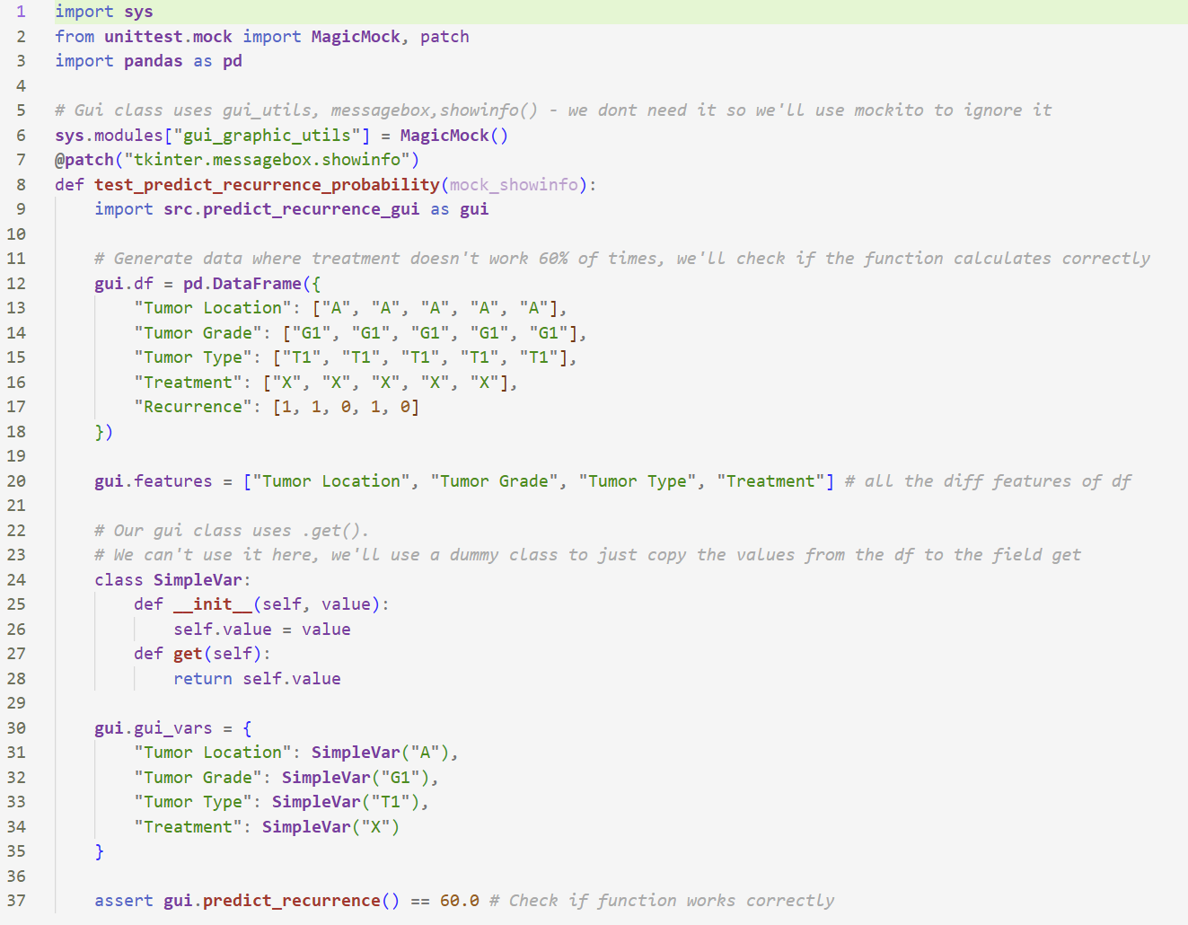
1. Can we predict the chances of a tumor recurrence based on its initial location?
Tests

Slide 8
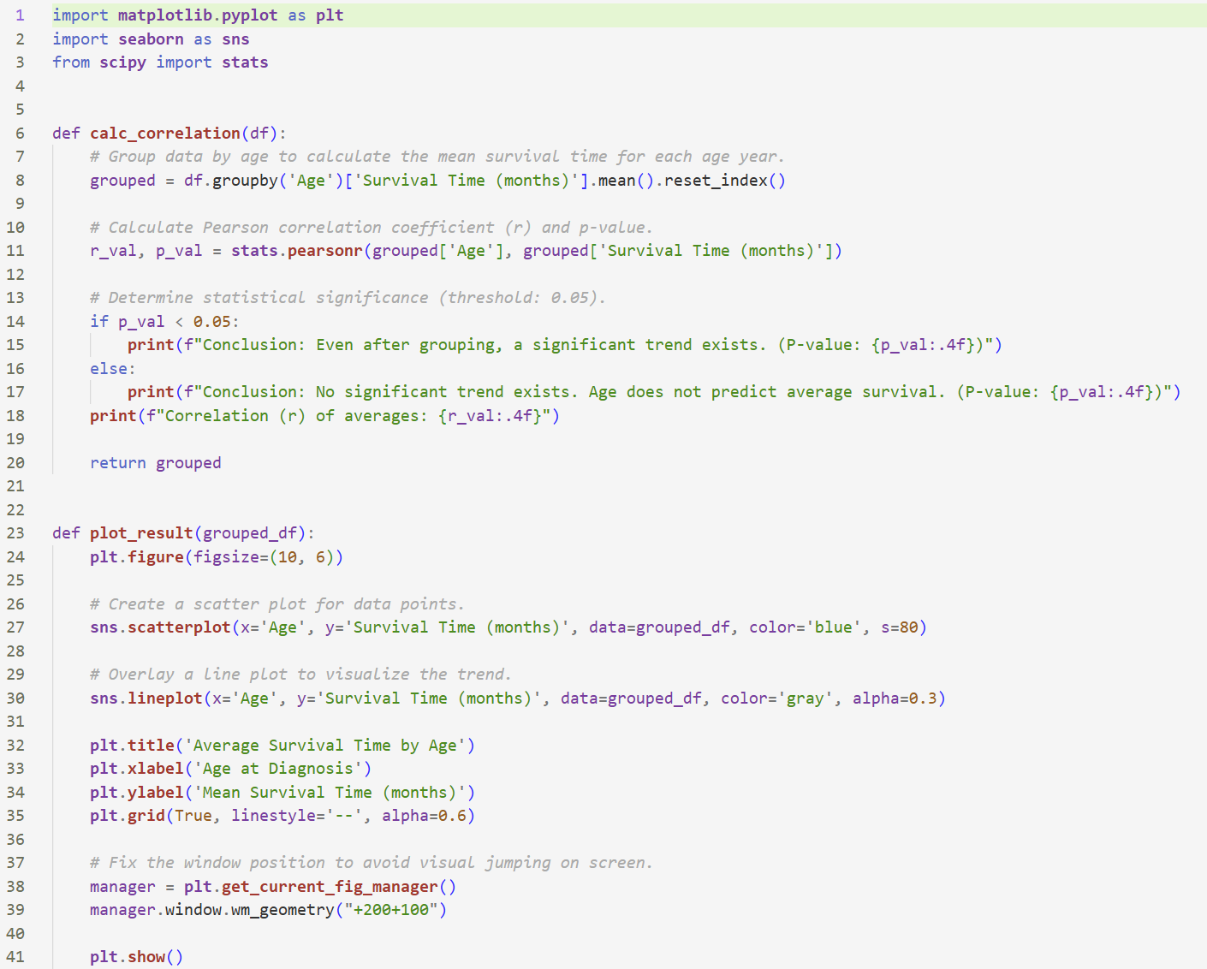
2. Is there a correlation between the survival time and the age of the patient (at the time of diagnosis)?
Final code

Slide 9
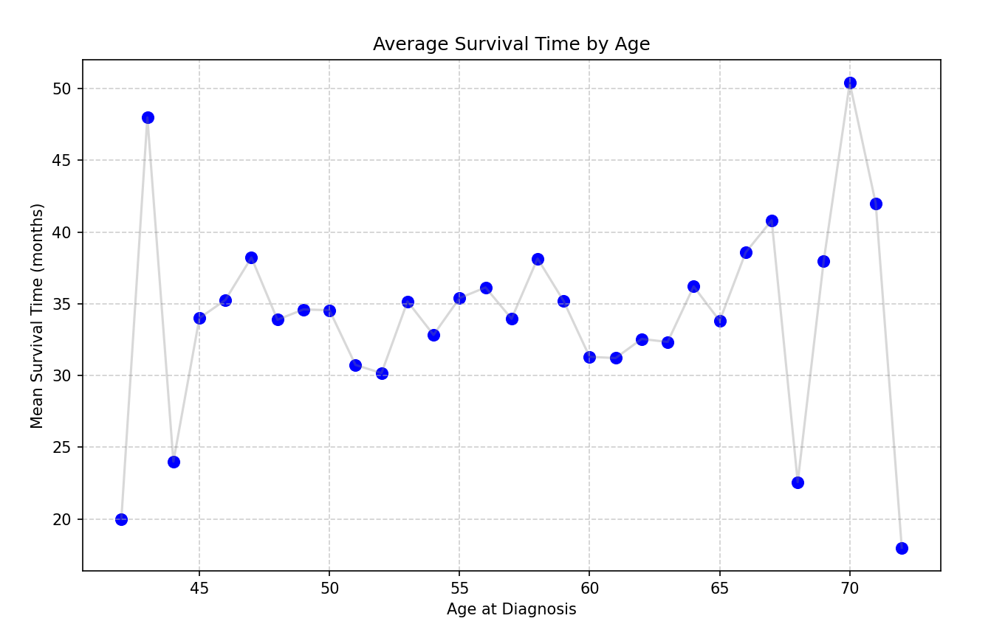
2. Is there a correlation between the survival time and the age of the patient (at the time of diagnosis)?
Results
Pearson correlation was used because both age and survival time are continuous variables, making it suitable for testing a linear relationship. The data was grouped by age and used average survival time to reduce noise and better match Pearson’s assumptions.

Slide 10
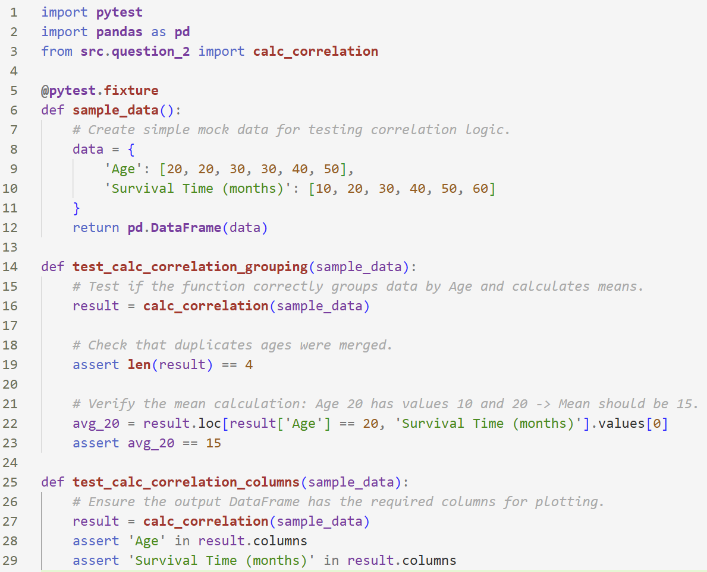
2. Is there a correlation between the survival time and the age of the patient (at the time of diagnosis)?
Tests

Slide 11
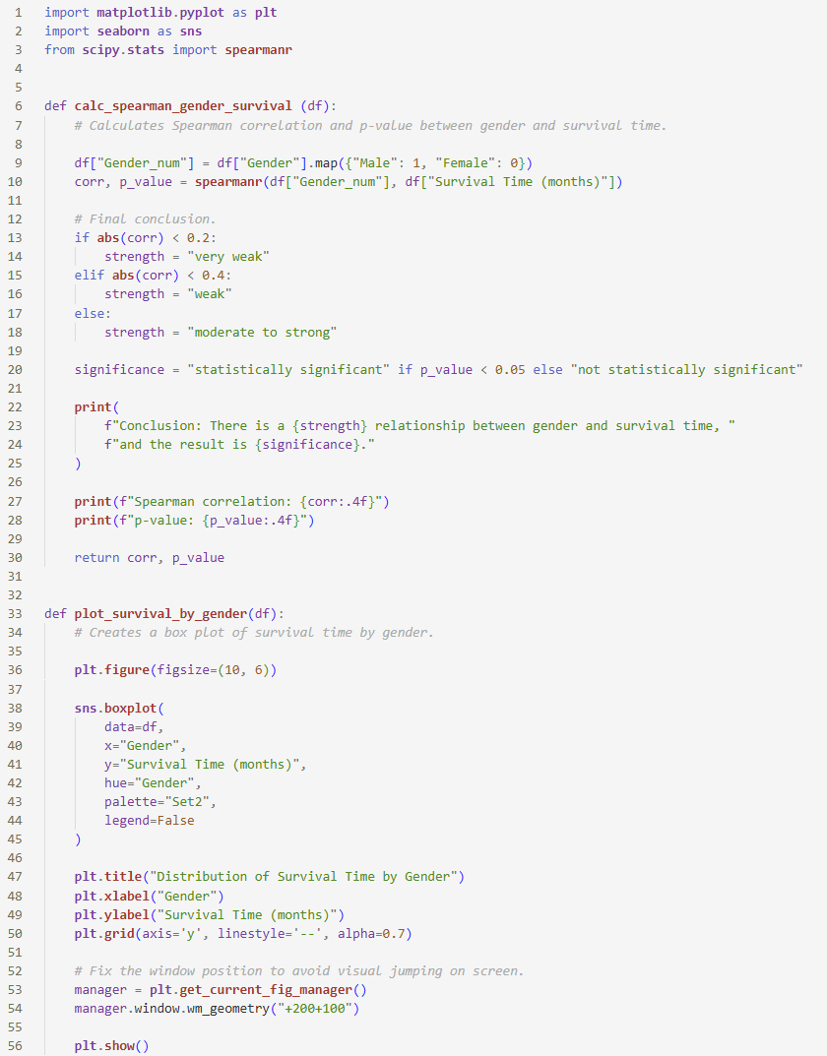
3. Is there a connection between the survival time and the patient's gender?
Final code

Slide 12
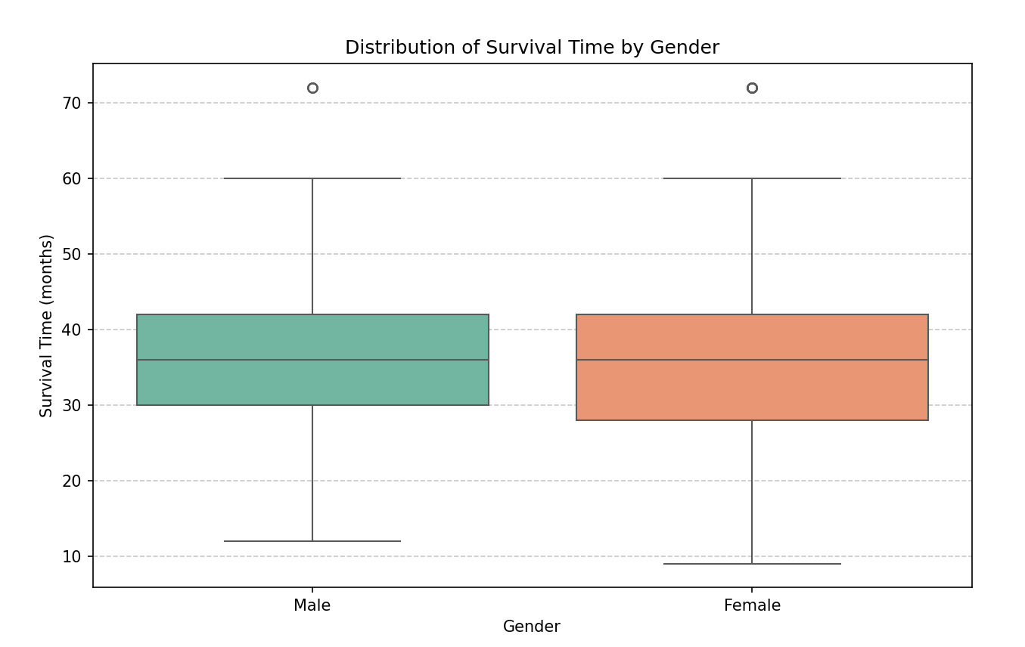
3. Is there a connection between the survival time and the patient's gender?
Results
Spearman correlation is used because gender is a categorical variable encoded numerically and survival time may not be normally distributed. This test checks for a monotonic and statistically significant relationship. The box plot complements the analysis by visually comparing the distribution, median, and variability of survival times between genders.

Slide 13
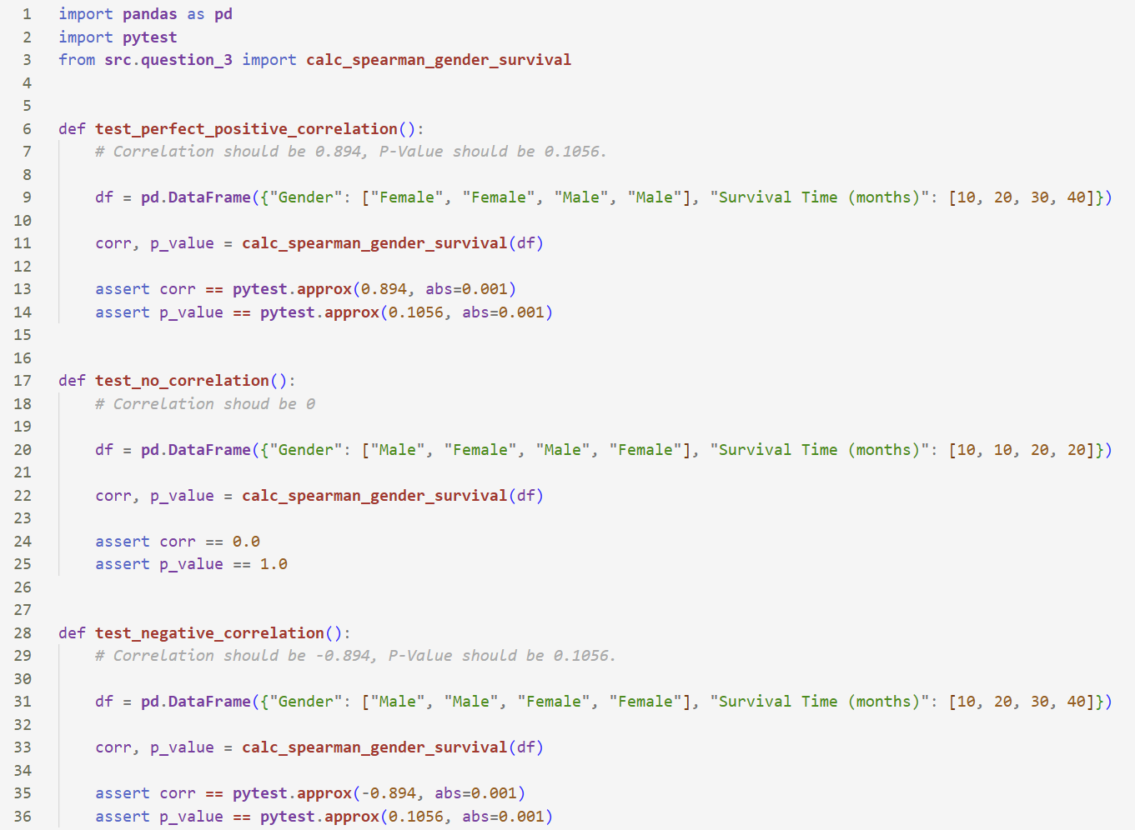
3. Is there a connection between the survival time and the patient's gender?
Tests

Slide 14
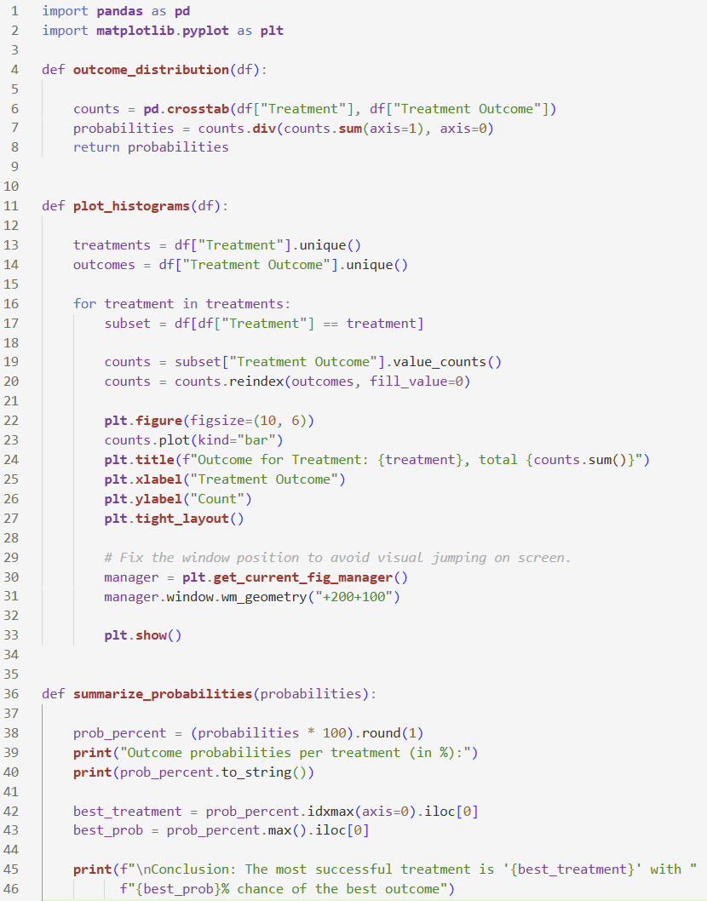
4. Can we predict the treatment outcome based on the chosen treatment?
Final code

Slide 15
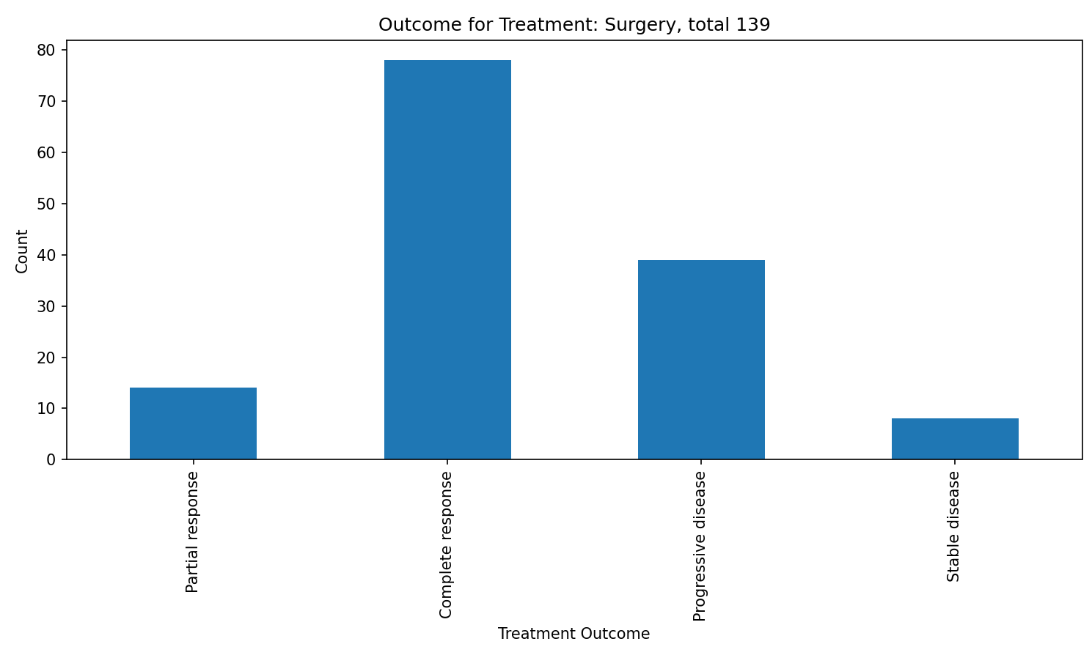
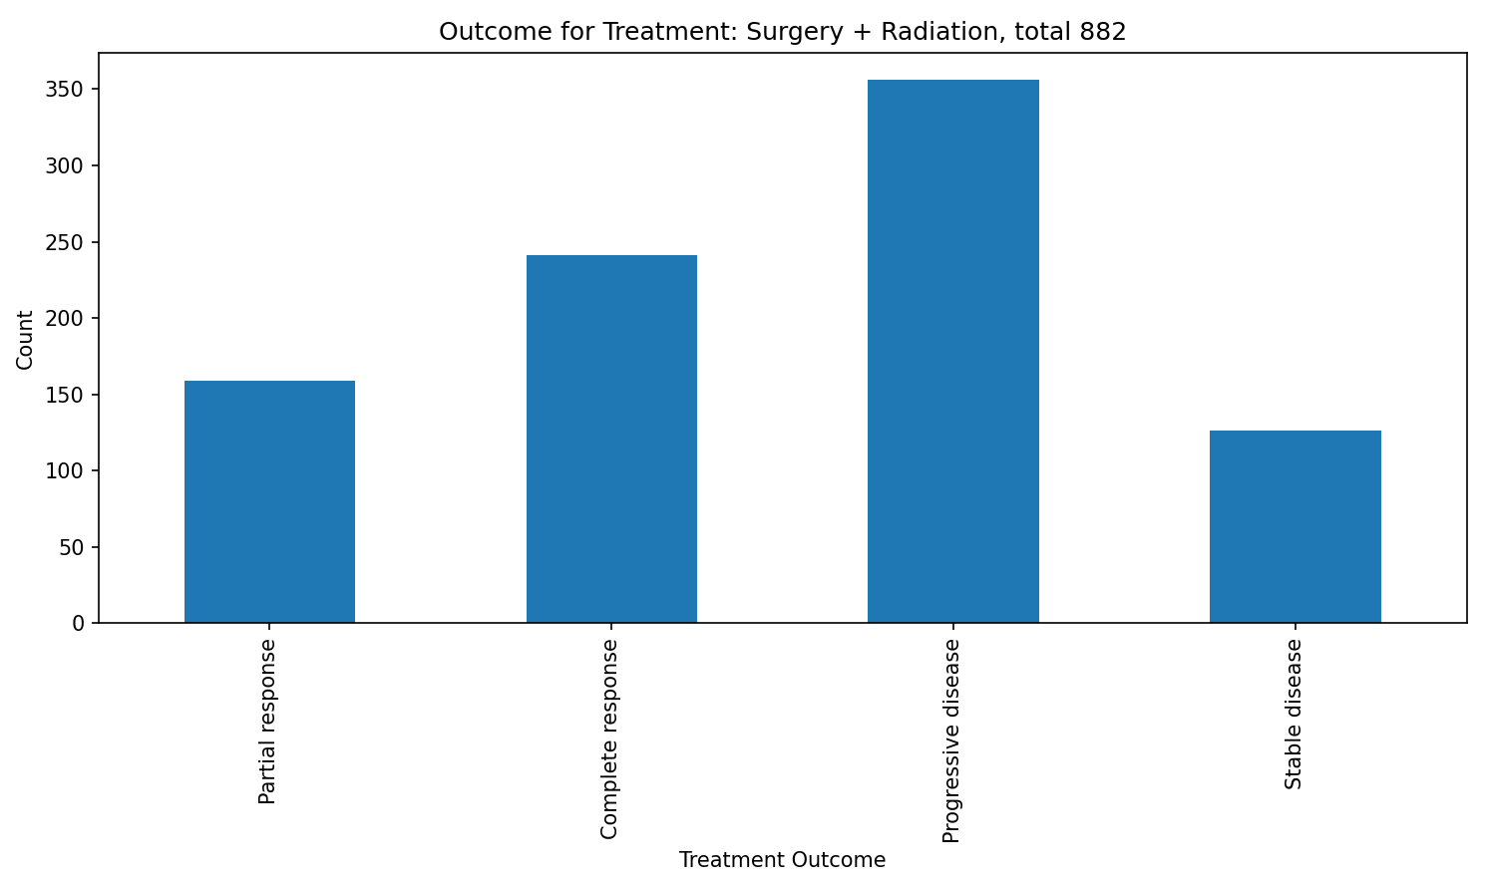
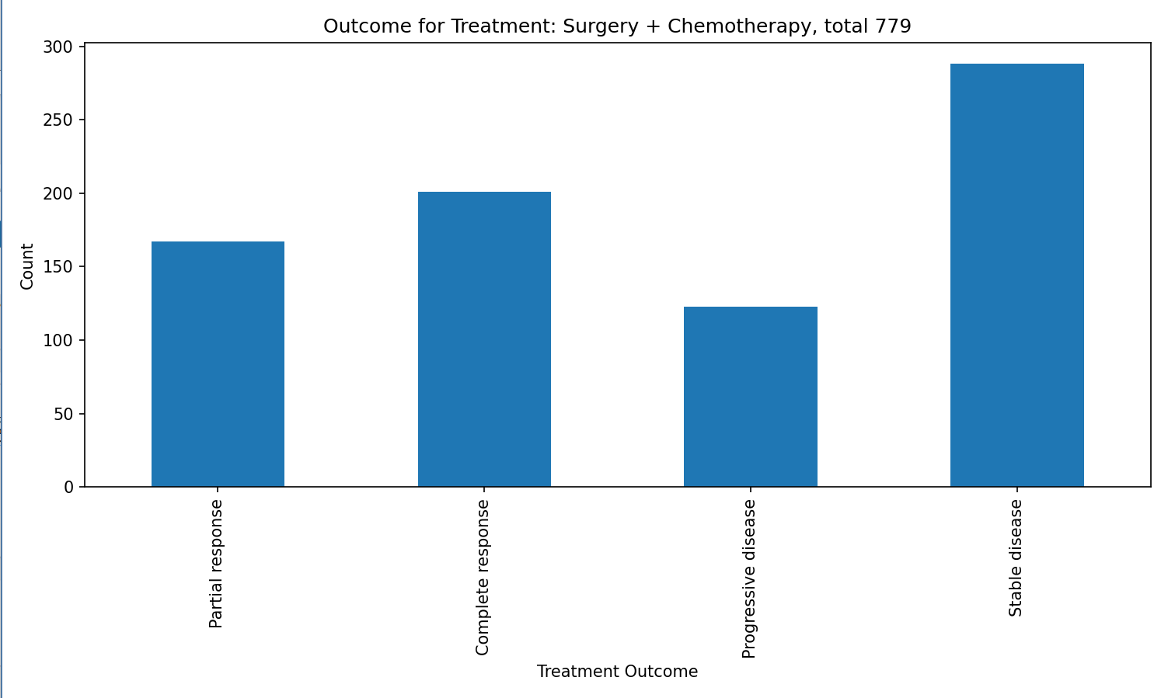
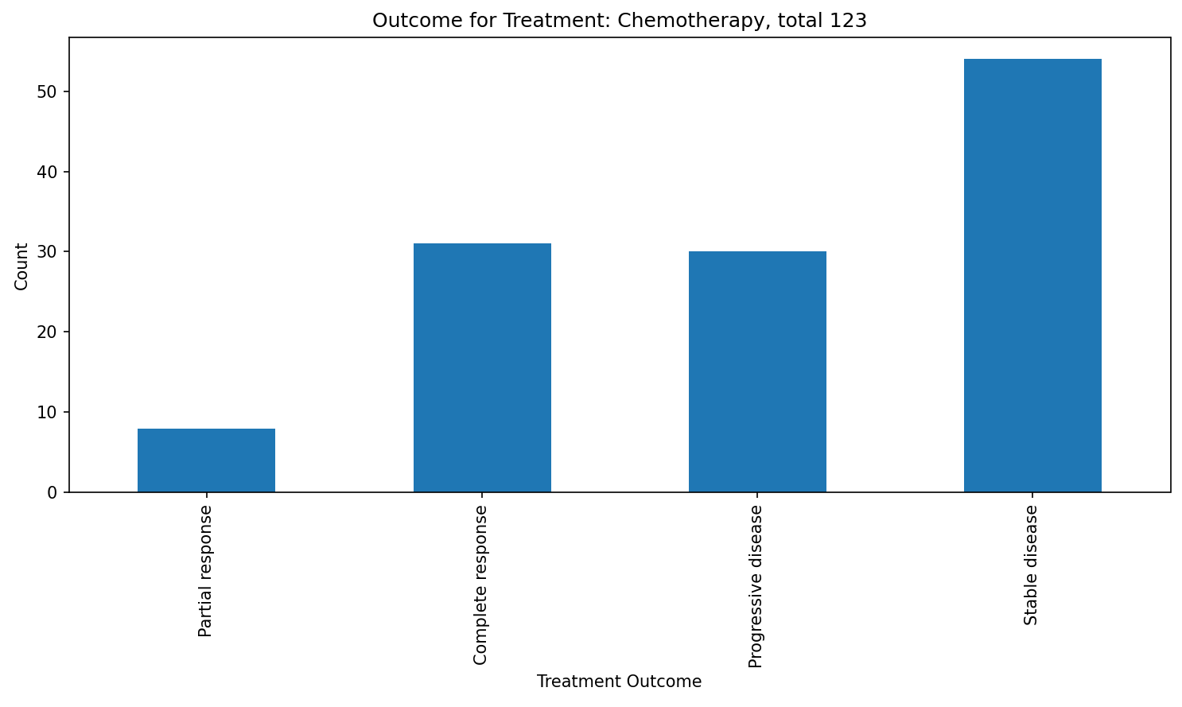
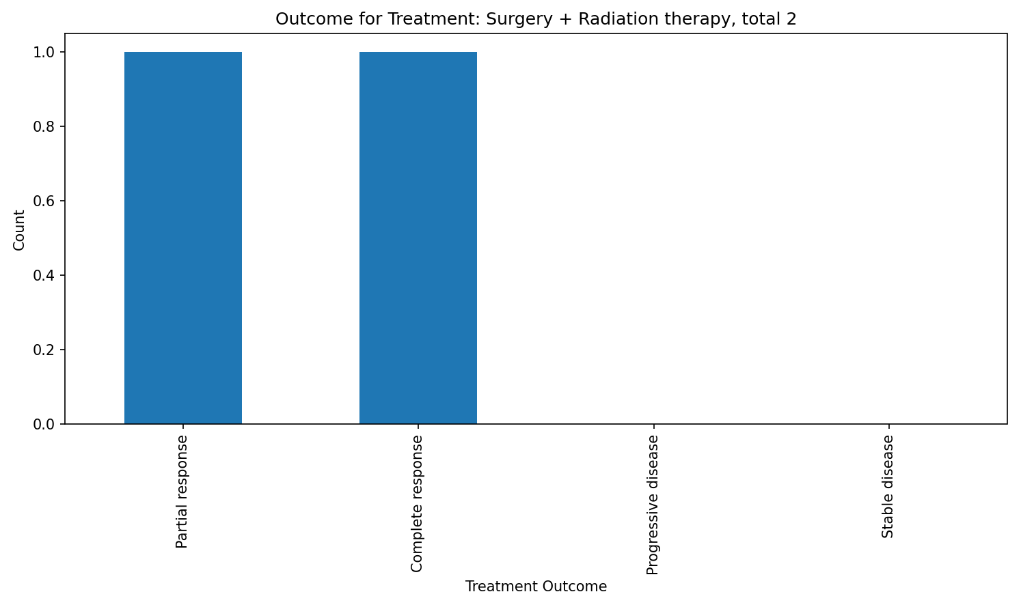
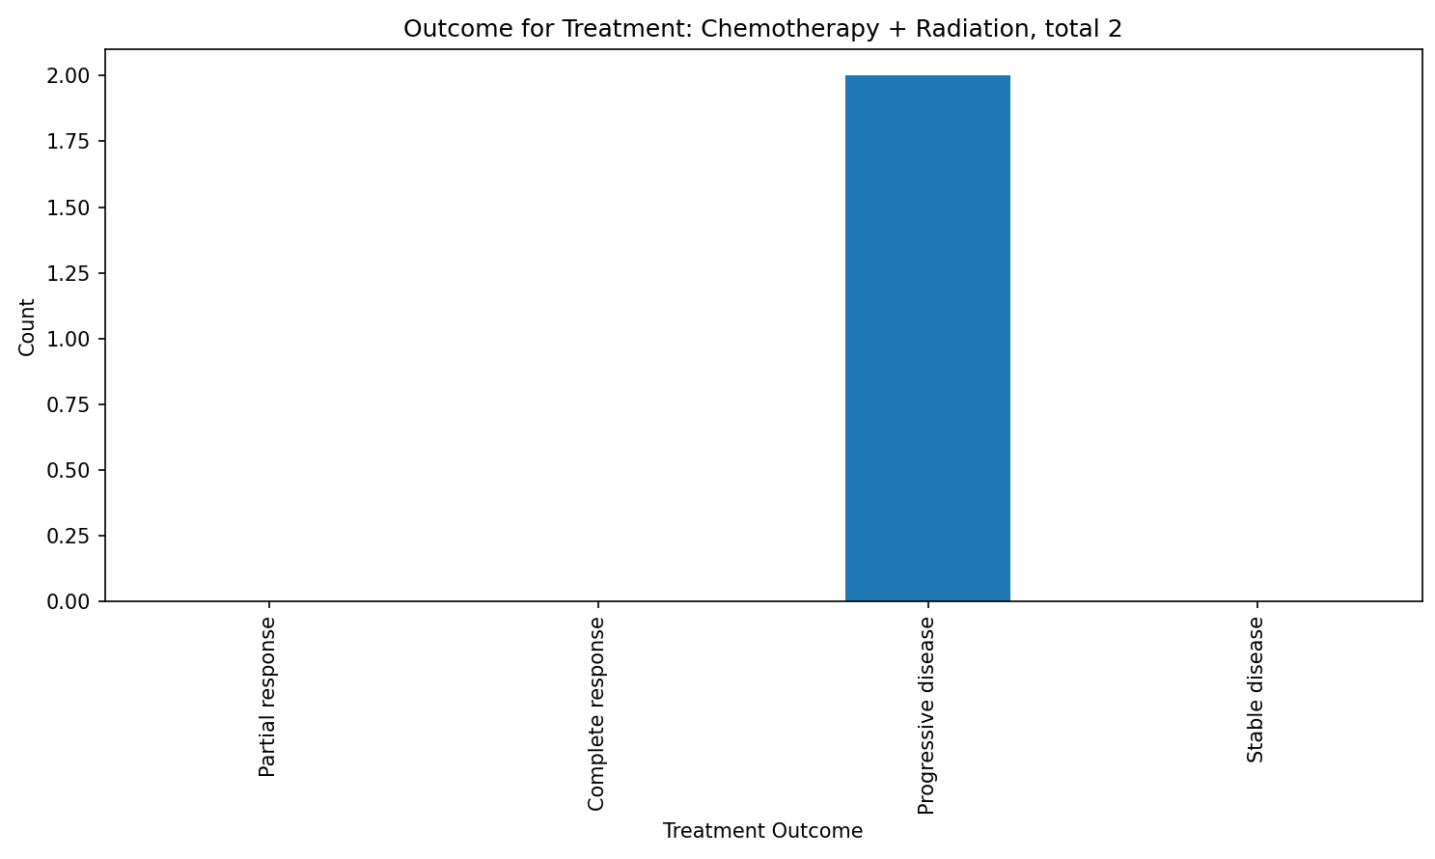
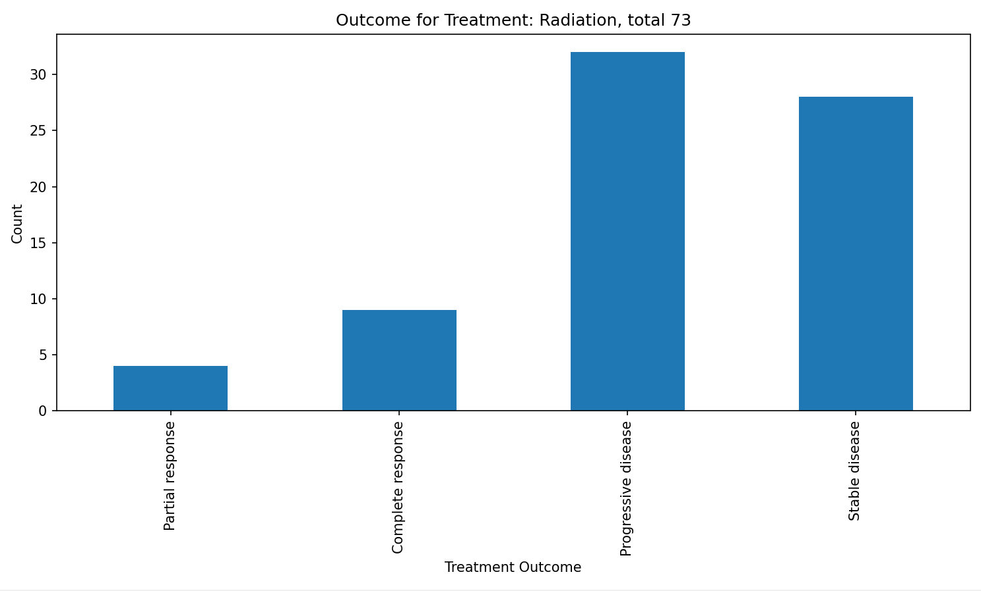
4. Can we predict the treatment outcome based on the chosen treatment?
Results

Slide 16
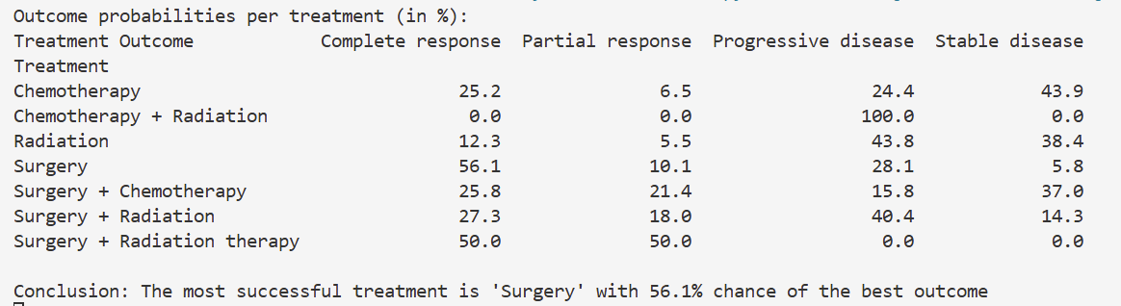
4. Can we predict the treatment outcome based on the chosen treatment?
Results
The code computes outcome probabilities for each treatment using cross-tabulation, allowing a fair comparison between treatments. It then visualizes the outcome distributions with bar charts to clearly show how outcomes differ across treatments. Together, the probabilities and plots help identify the most effective treatment and support the final conclusion.

Slide 17
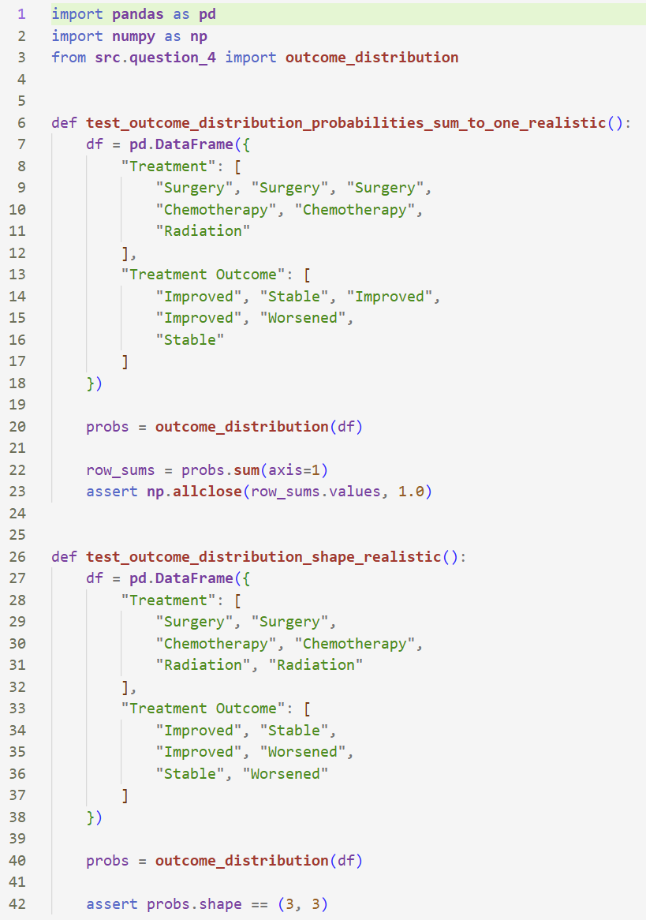
4. Can we predict the treatment outcome based on the chosen treatment?
Tests

Slide 18
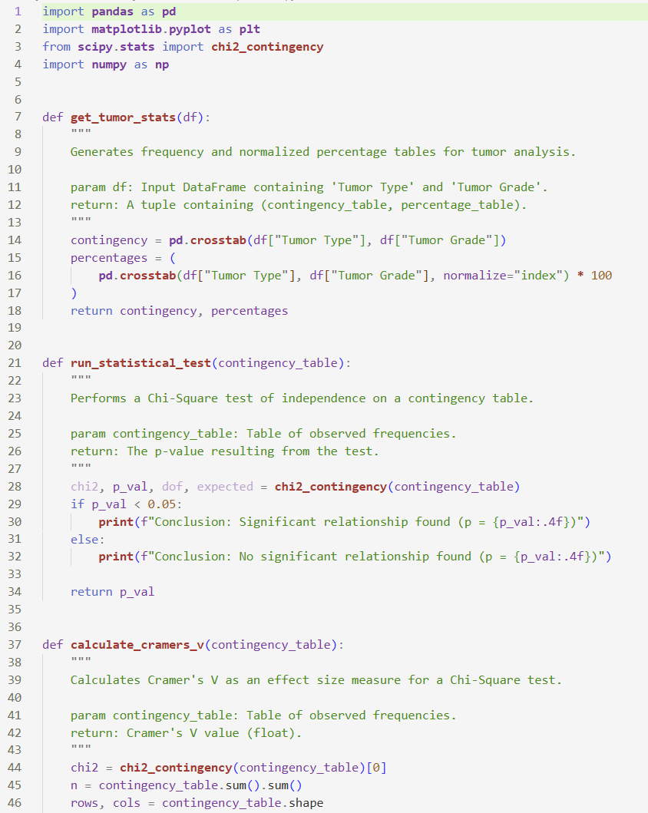
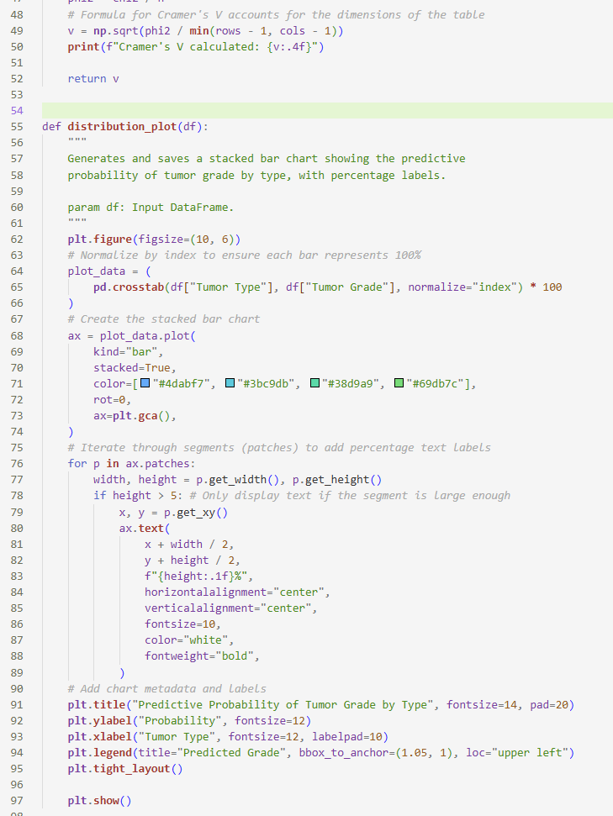
5. Can tumor type predict the tumor grade at initial diagnosis?
Final code

Slide 19
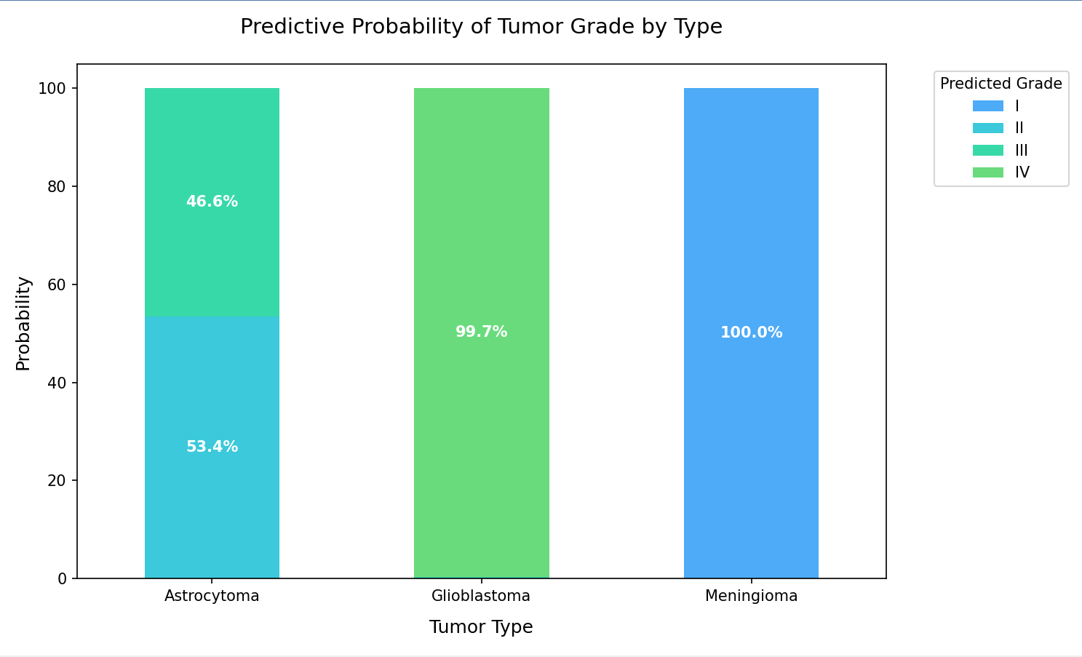
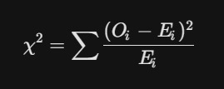
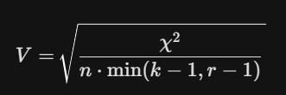
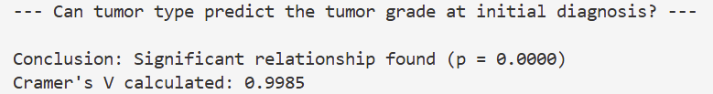
5. Can tumor type predict the tumor grade at initial diagnosis?
Results
A cross-tabulation was used to examine the relationship between tumor type and tumor grade.
A chi-square test showed a statistically significant association, and Cramér’s V indicated that the relationship is strong.
A stacked bar chart with percentages was used to clearly compare grade distributions across tumor types, even with different sample sizes.

Slide 20
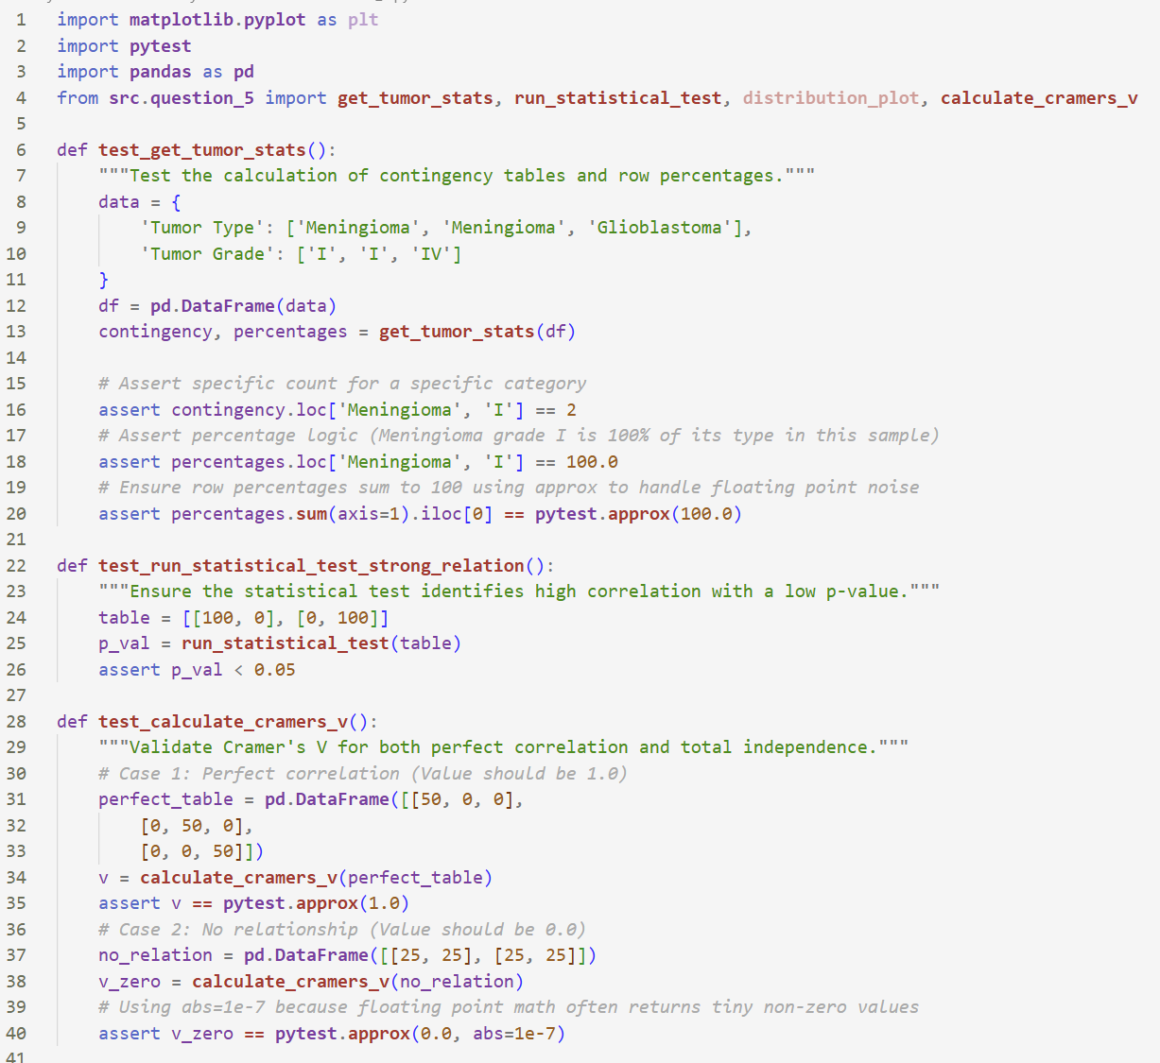
5. Can tumor type predict the tumor grade at initial diagnosis?
Tests

Slide 21
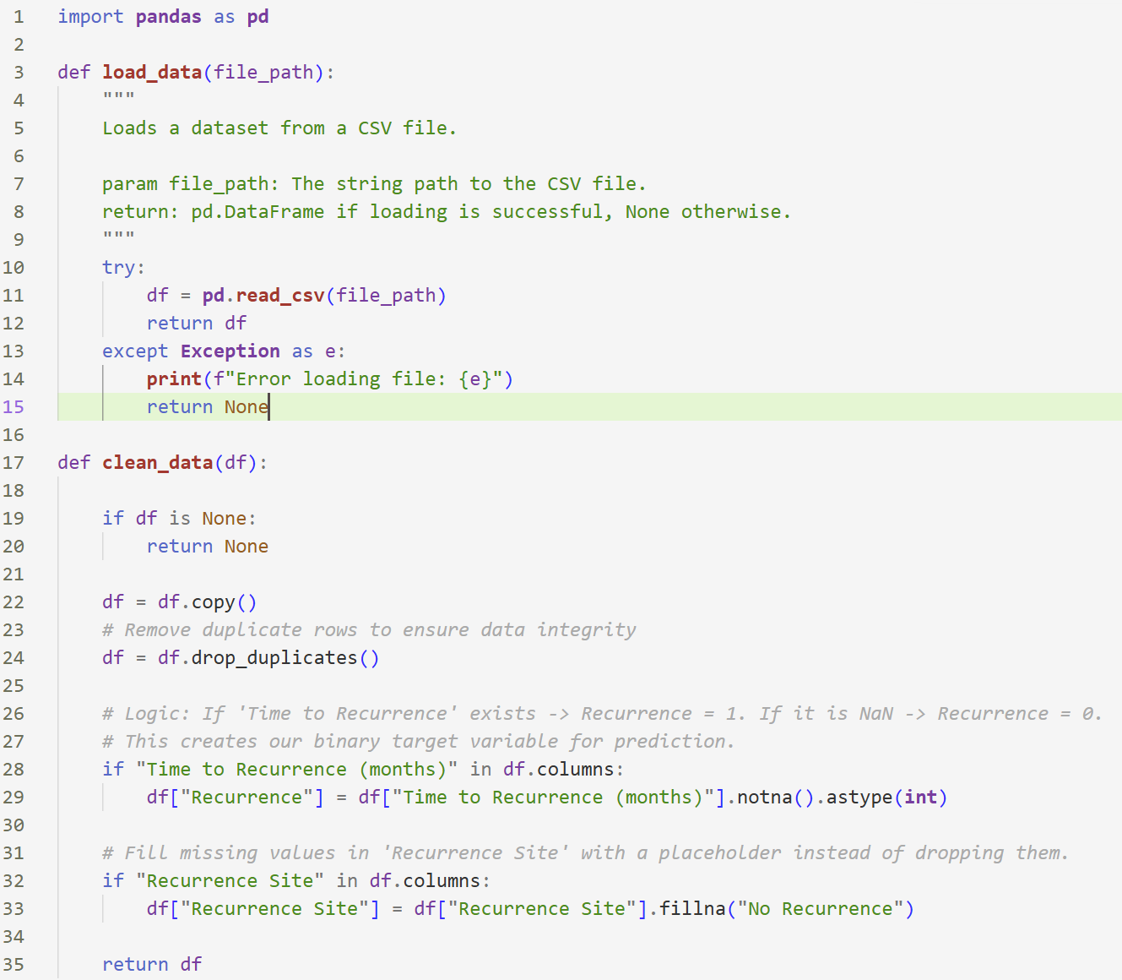
Clean data

Slide 22
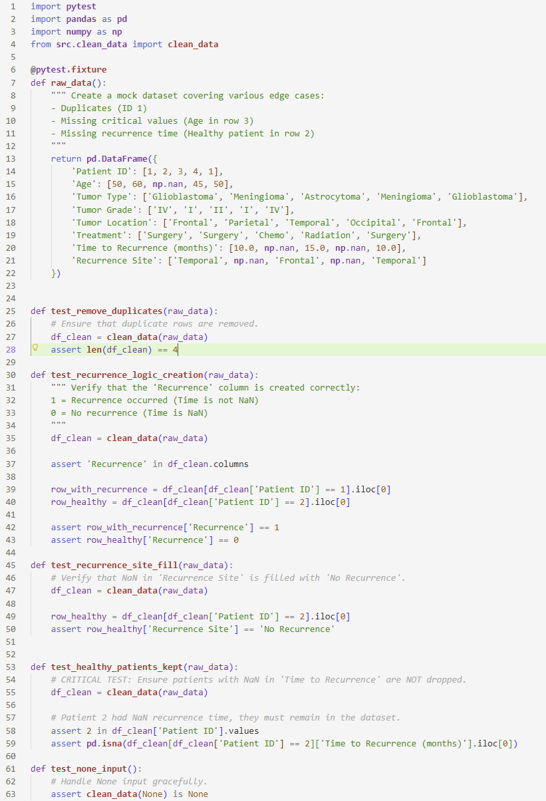
Clean data
Test

Slide 23
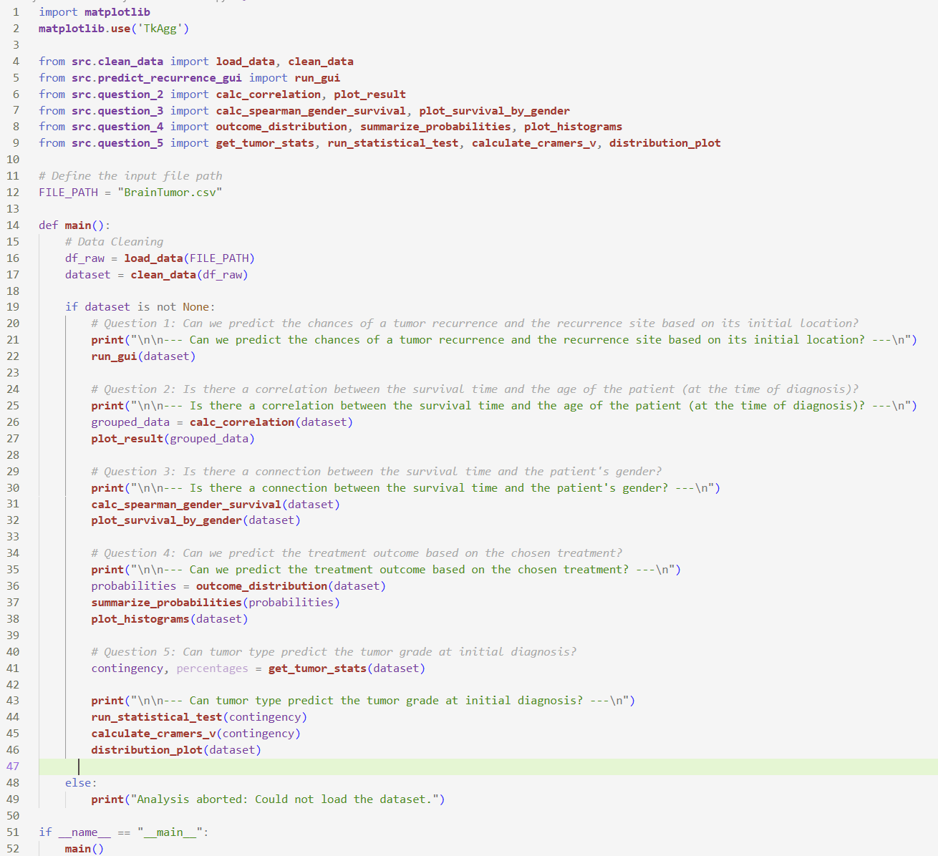
Main ()

Slide 24
Thanks for watching

